Slide 1
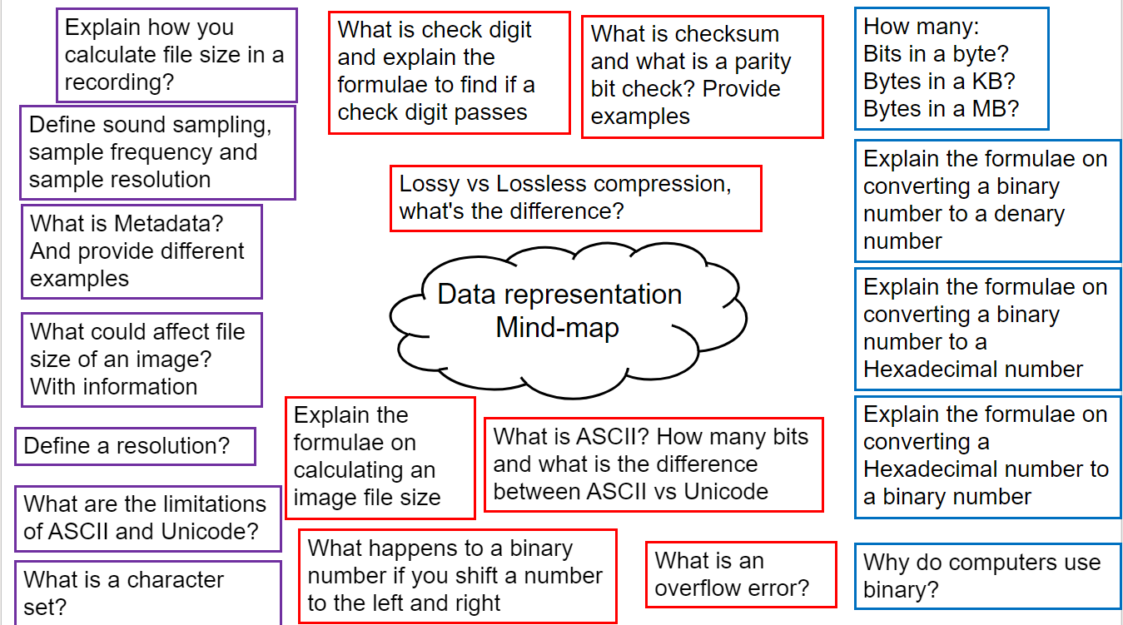

Slide 2
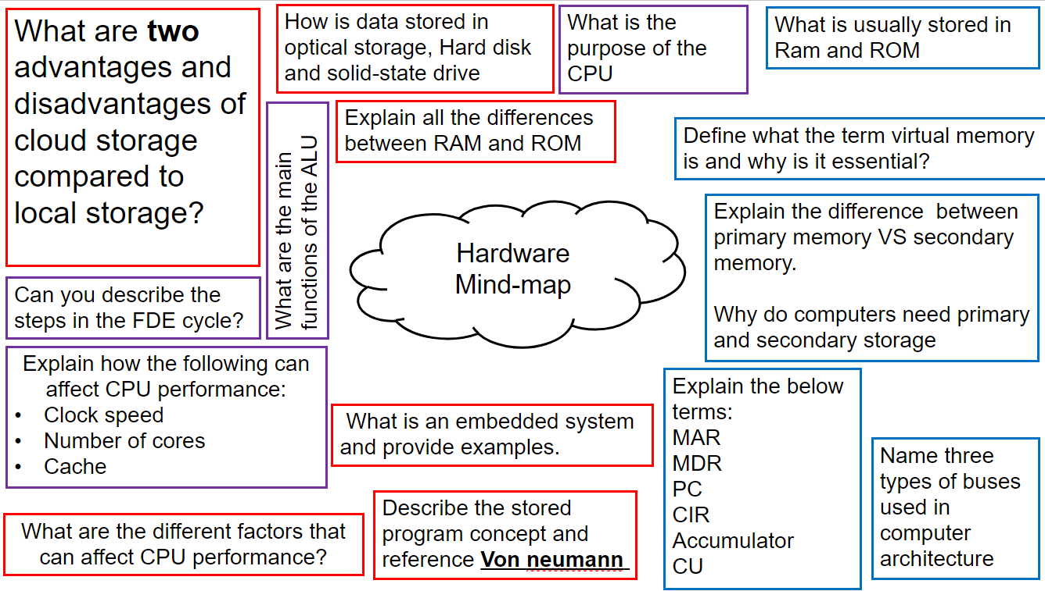

Slide 3
Topic 6
Algorithms
pseudocode/flowcharts

Slide 4
